Slide 1
GenAI Industry Dynamics
Ted Kwartler

Slide 2
What is Gen(erative) AI?
A genAI model is a “conditional probability model” it generates the next word, character and phrase
If knows what you have…the beginning of the sentence/user prompt
It predicts the sequence “whats the next work going to be?” but has prior information “what words have already come before?
A genAI model is a “conditional probability model” it generates the next word, character and phrase

Slide 3
Given some prior conditions, what is next?
Condition
Completion
Cat 15%
Bone 8%
… …
Printer 0.01%
Total 100%
The dog chased the

Slide 4
Data science methods can largely be grouped into supervised & unsupervised learning.
Supervised
Unsupervised
Definition: Learning from labeled data to make predictions on new, unseen data
Examples:
Image classification (e.g., dog vs cat)
Sentiment analysis (e.g., positive vs negative review)
Predicting house prices based on features like size and location
Goal: Learn a mapping between input data and correct outputs
Definition: Discovering patterns and structure in unlabeled data
Examples:
Clustering customers based on buying behavior
Dimensionality reduction (e.g., PCA for visualization)
Anomaly detection (e.g., identifying outliers in network traffic)
Goal: Identify hidden relationships or groupings in the data
Key Differences
Labeled vs unlabeled data
Prediction vs pattern discovery
Focus on accuracy vs exploration

Slide 5
Supervised Learning requires labeled data.
Labeled Data
Dog pic, dog pic, dog pic, cat pic, dog pic, …
Unsupervised vs supervised, animate the label of each photo to show its supervised
Then show a new cat pic and have the model predict it’s a cat

Slide 6
Training a supervised model
X is a bunch of inputs ---pics of dogs and cats
Y is the label cat or dog for each one
Model Object icon
Training data can take many forms
Prediction context - image recognition – labeled photos of animals
Translation – English to French; French to German documents
Customer propensities – customer attributes and customer actions

Slide 7
Predicting with a supervised model
Supervised Inference
Dog picture with a probability of “dog” label
New dog picture comes along the model object is applied
Model Object icon
Along comes new…
Prediction context - image recognition – new photo of a furry pet animal…betas applied therefore ??
Translation – new English document/sentence…betas applied therefore ??
Customer propensities – new custom record…betas applied therefore ??

Slide 8
Unsupervised training has no labels, only data.
Unlabeled Data
Dog pic, dog pic, dog pic, cat pic, dog pic, …
Show a grouping among the photos of similar pictures but note that it doesn’t know the names of the animals
Unsupervised model with clusters inside

Slide 9
Predicting with a unsupervised model
Unsupervised Inference
Unsupervised model with clusters inside
Dog picture is assigned a cluster with no label called “dog” just a cluster number
New dog picture comes along the model object is applied
Along comes new…
Image Grouping - image recognition – new photo of a furry pet animal…object applied therefore ??
Document Topics – new English document/sentence…object applied therefore ??
Customer Persona Grouping – new custom record…object applied therefore ??

Slide 10
What are the model objects?
Model Object icon
Unsupervised model with clusters inside
Both have learned characteristics of the data it was provided.
Often called weights or betas that describe the patterns in the data
Parameters that control the learning process or define the structure of the data

Slide 11
Generative AI is fancy supervised learning, using self-supervised learning. This is fundamental to all genAI models.
Training Data
The dog chased the cat.
Self-supervised learning
Model Object
“Lookup table” of language characteristics
Output
The dog chased the ___.
cat
Cat 15%
Bone 8%
… …
Printer 0.01%
Total 100%
The dog ___ the cat.
chased
The ___ chased the cat.
dog

Slide 12
What about images?
Training Data
Cat image
Self-supervised learning…applied to pixels
Model Object
“Lookup table” of language characteristics
Output
Cat image A missing section A
section A
Section A is Cat image A 15%
Section A is Cat image B 8%
… …
Section A is Cat image C 0.01%
Total 100%
Cat image B missing section B
section B
Cat image C missing section C
section C

Slide 13
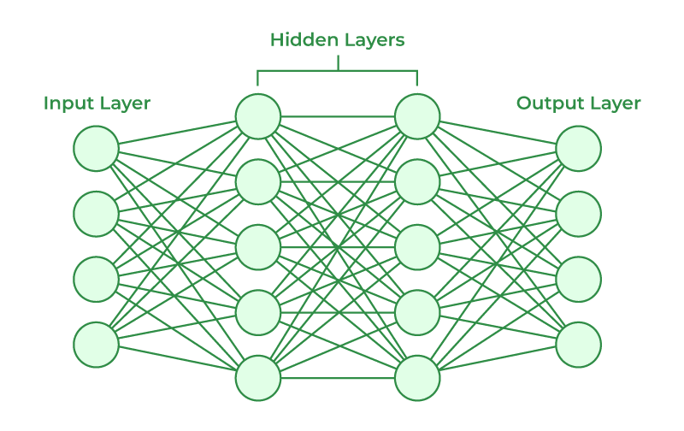
A Neural Network is a model of weights
Input layer
Hidden layer
Output layer

Slide 14
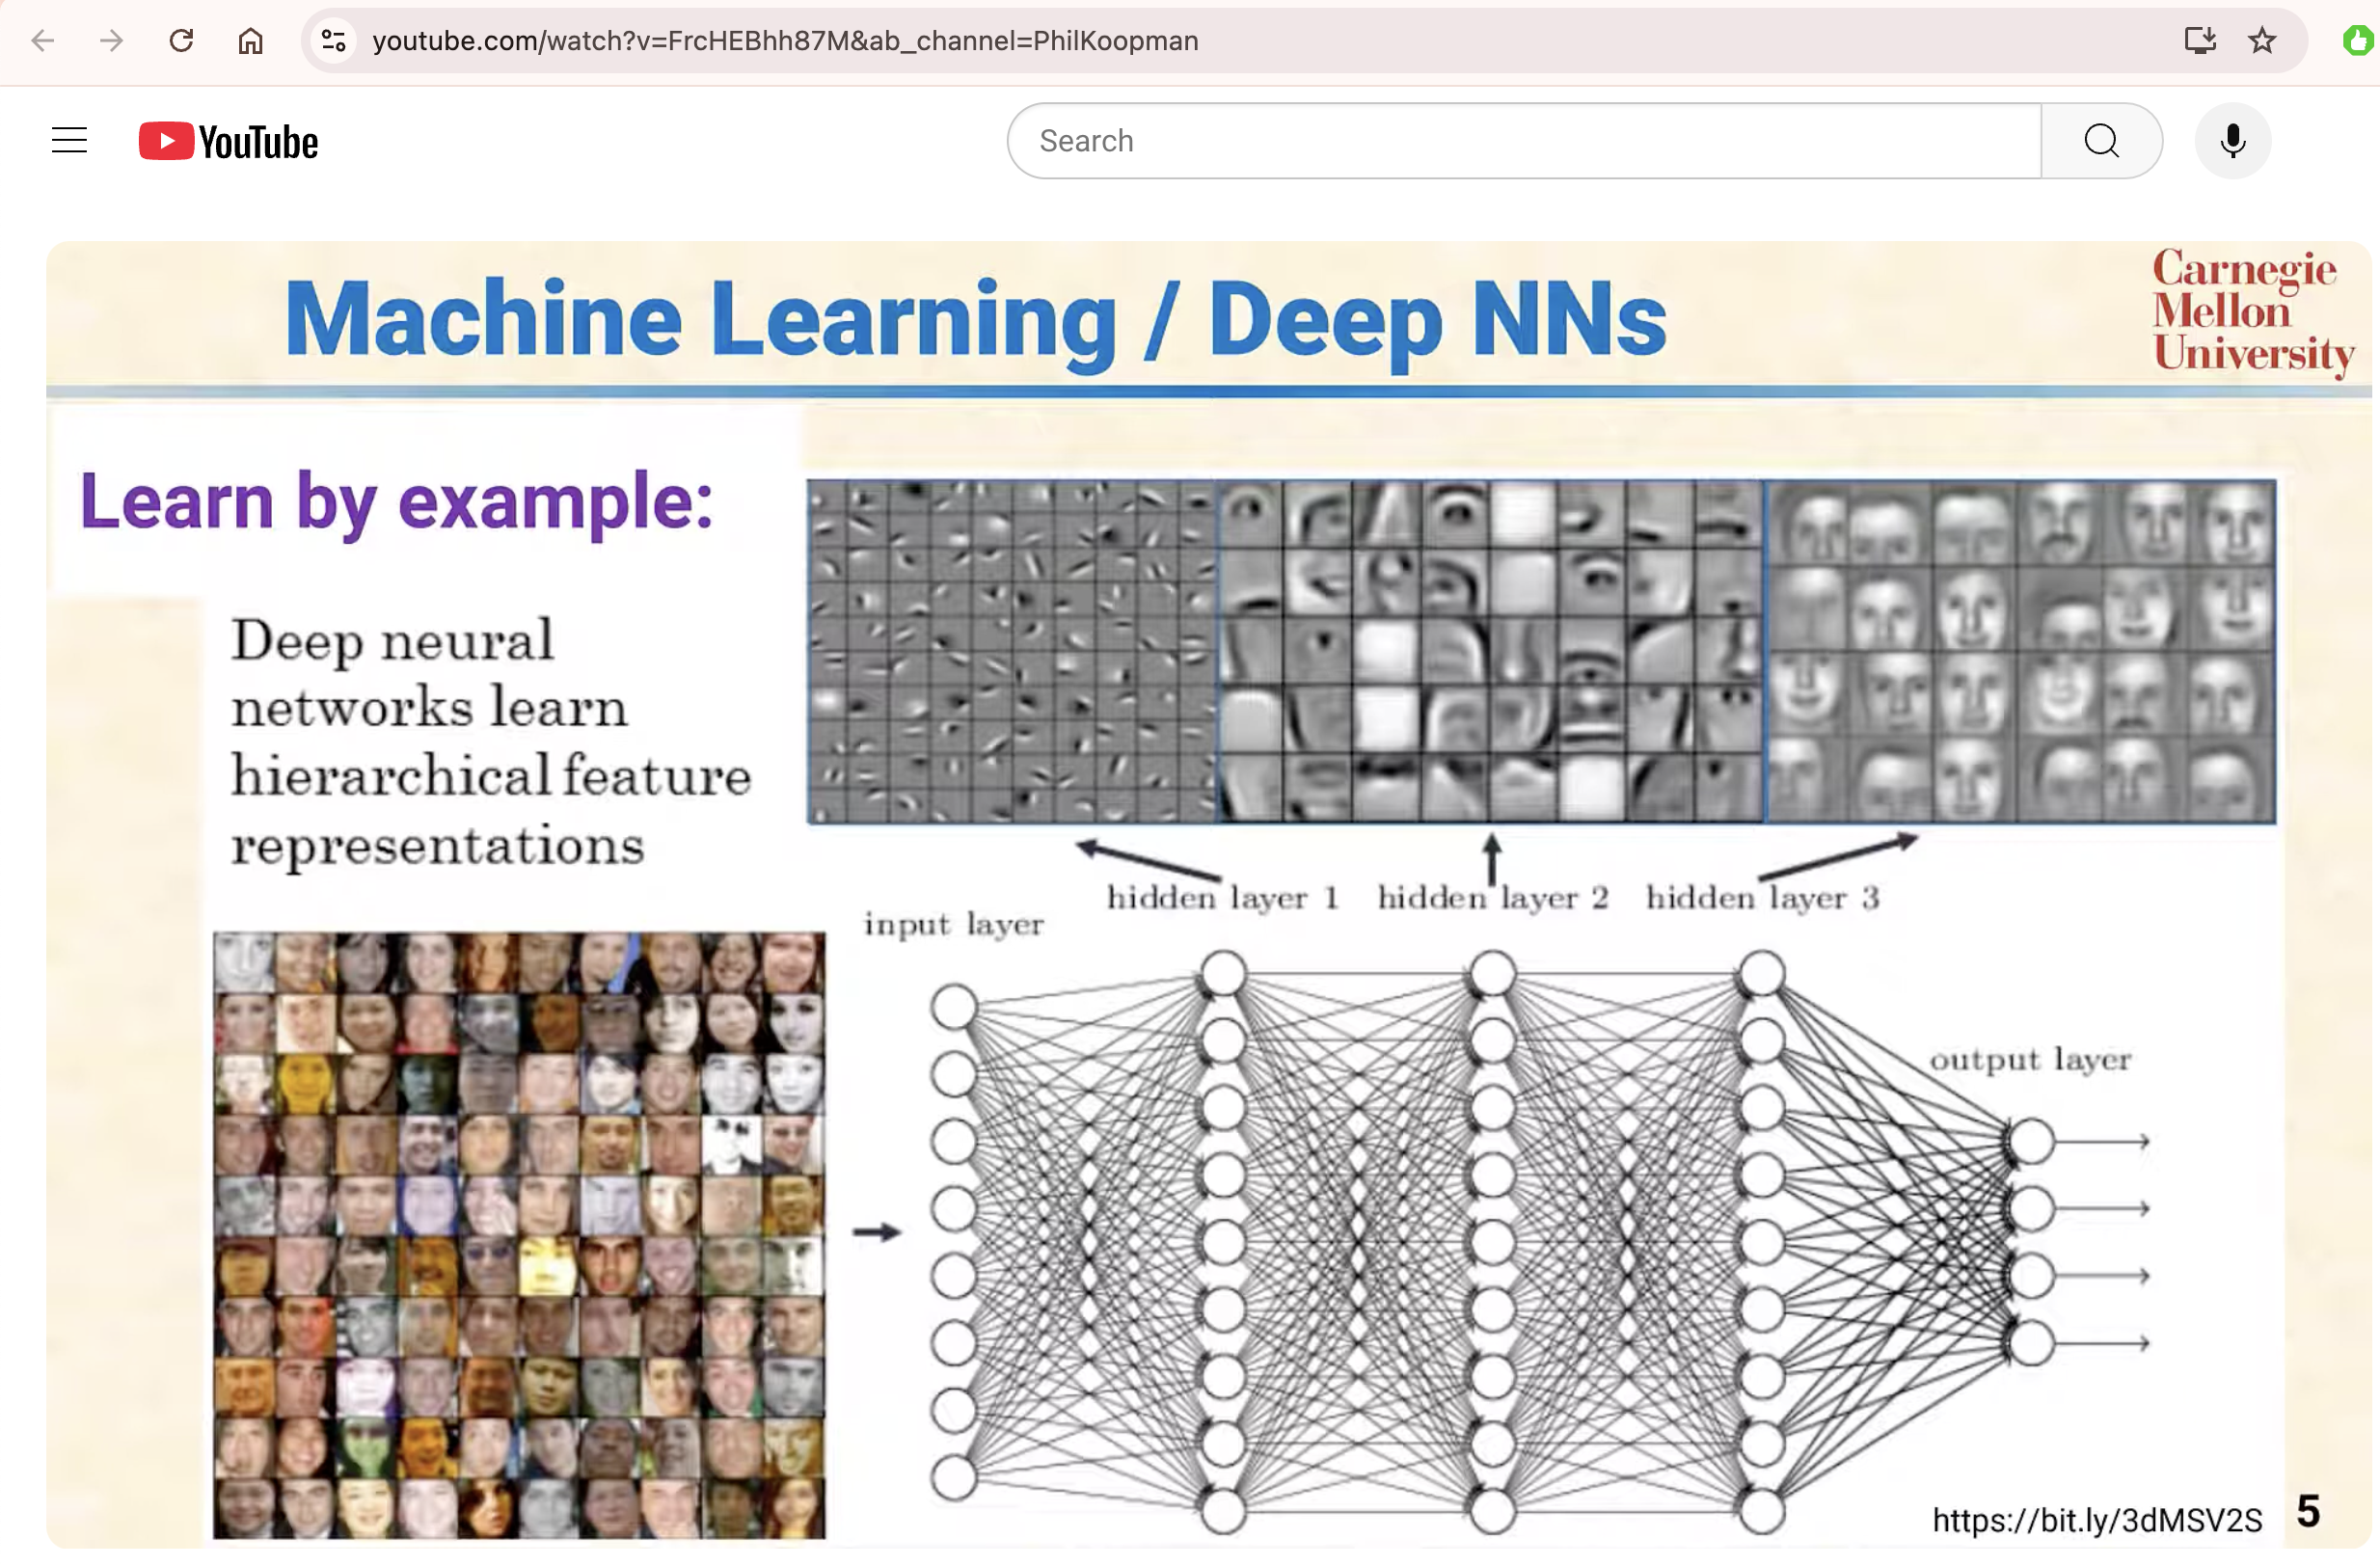
Intermediate features are automatically generated and are feature representations
https://towardsdatascience.com/the-why-and-the-how-of-deep-metric-learning-e70e16e199c0

Slide 15
Pandemonium Architecture Slide

Slide 16
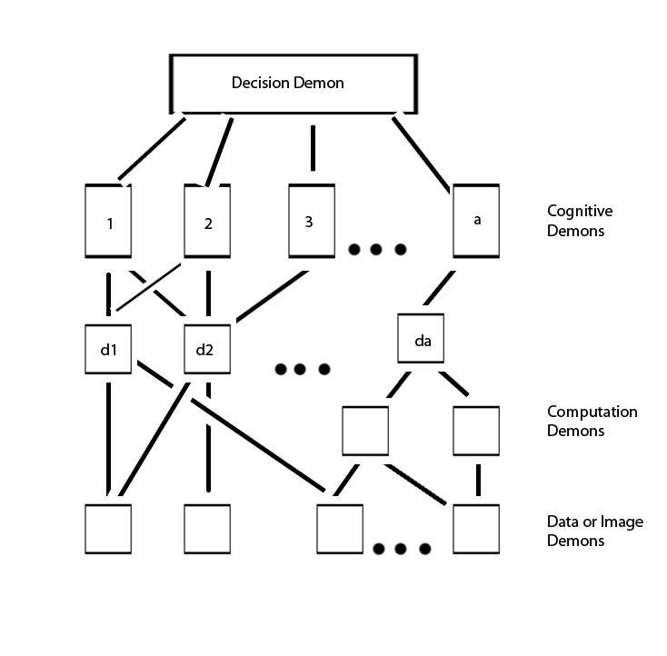
But Conceptually computer scientists have been thinking like this for a long time.
The theory was developed by the artificial intelligence pioneer Oliver Selfridge in 1959.
https://en.wikipedia.org/wiki/Pandemonium_architecture#/media/File:Original_pande2.jpg

Slide 17
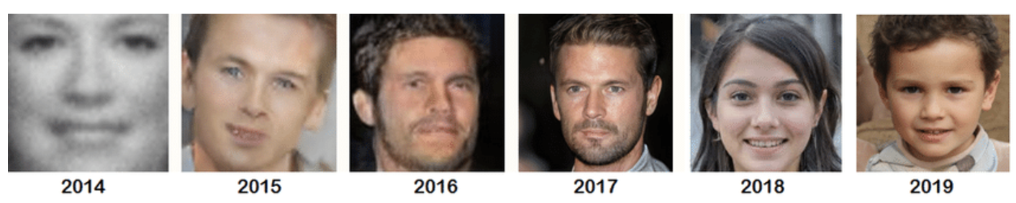
Significant progress has been made in the last 10 years.
GAN progress
https://www.researchgate.net/figure/Evolution-of-the-GANs-from-year-2014-to-2019_fig3_352096439

Slide 18
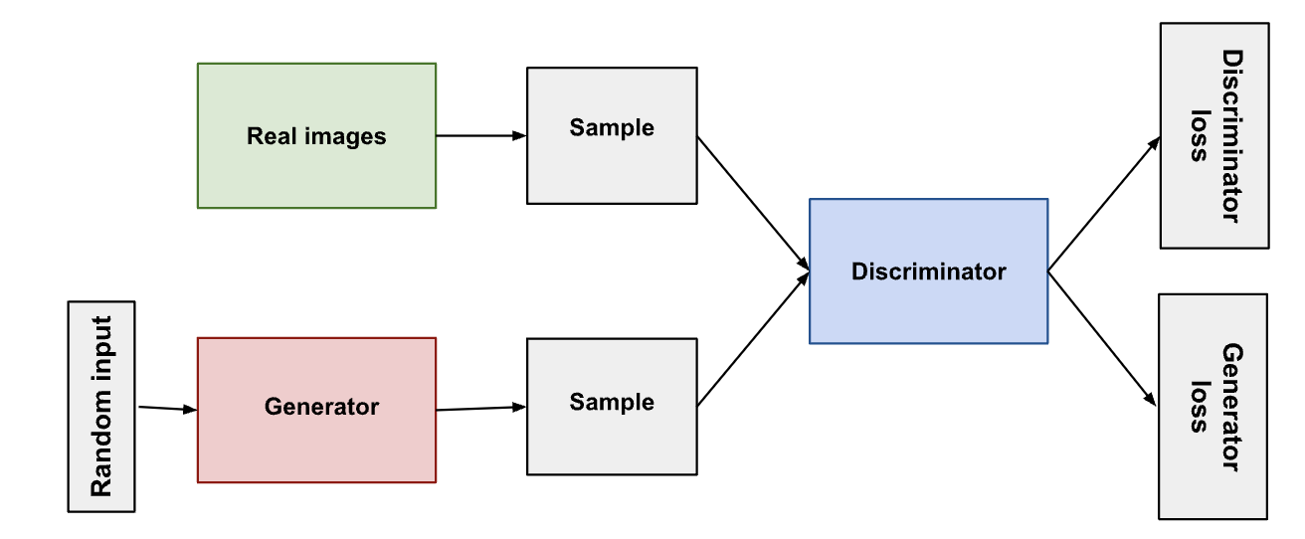
Generative Adversarial Networks (GANs) are a Neural Network Advancement
https://developers.google.com/machine-learning/gan/gan_structure

Slide 19
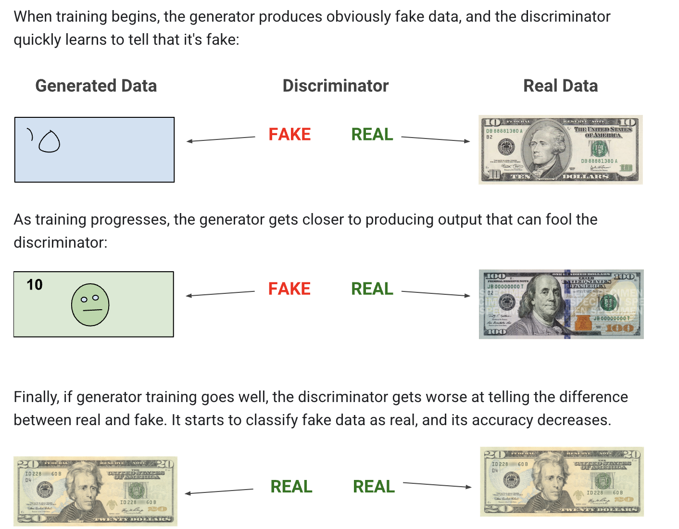
Generative Adversarial Networks (GANs) are a special type of neural network.
https://developers.google.com/machine-learning/gan/gan_structure

Slide 20

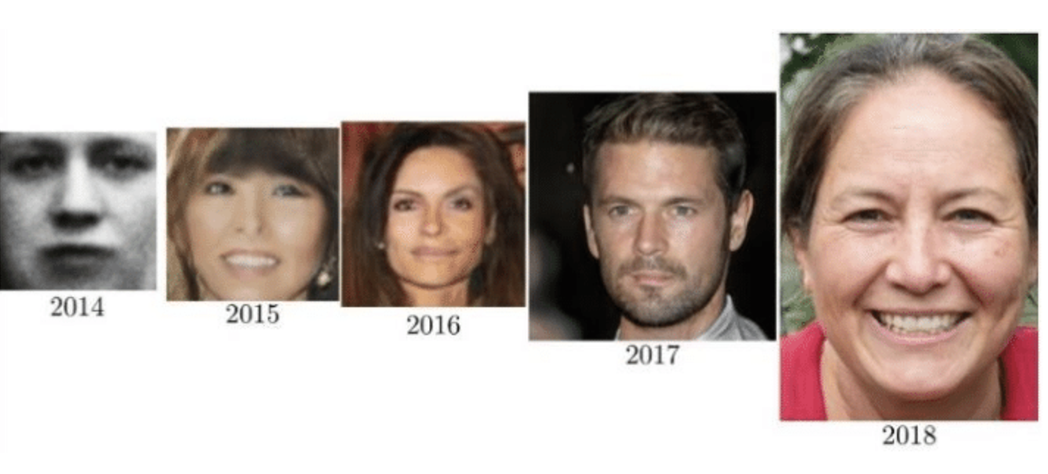
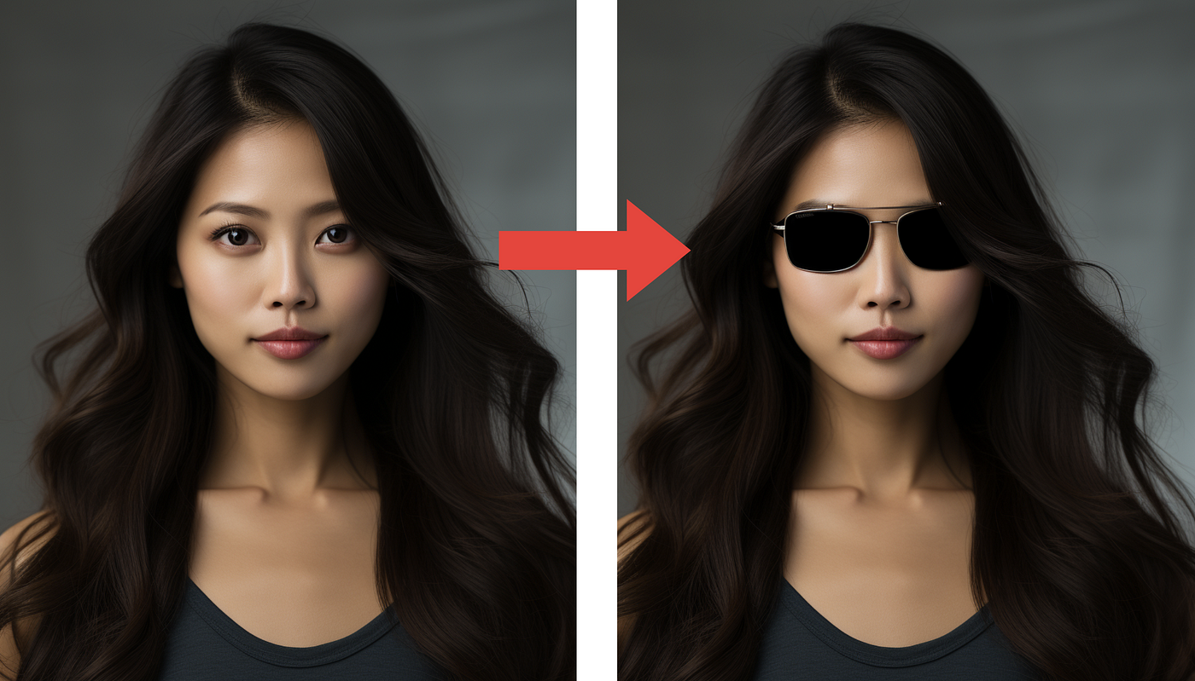
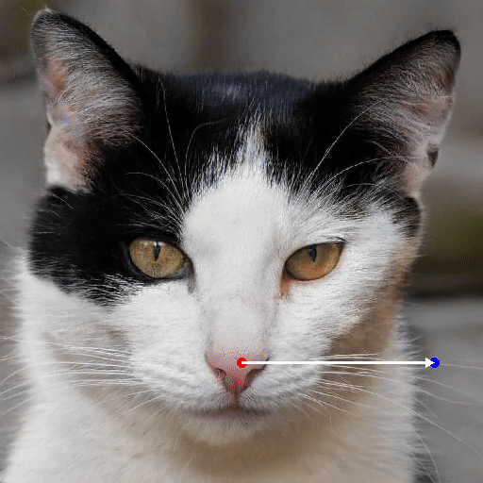
GANs have progressed in accuracy & application
outpainting
inpainting
DragGAN
https://www.researchgate.net/figure/years-of-GAN-progress-on-face-generation-20147-201510-201611-201712-201813_fig2_341699736

Slide 21
If the idea of AI is more than neural network and pattern recognition is more than 65 years old and even GANs are more than 10 years old, why is genAI a big deal now?
Data
Data proliferation (enterprise, consumer, internet…)*
Cheap Data storage
Methods
Self-supervised learning breakthrough
GANs and other types of neural network architectures
Compute
Cheaper/Faster (Moore’s Law*)
Parallel processing
Neural Networks can contain billions of parameters
Proponents are saying we’re are at an inflection since multiple factors have come together.
*According to IDC, the world's data will grow from about 29 zettabytes (ZB) in 2018 to 175 ZB by 2025, a growth rate of 66% per year. 45-90% of data becomes “cold” within weeks of its creation.
*the principle that the speed and capability of computers can be expected to double every two years, as a result of increases in the number of transistors a microchip can contain.

Slide 22
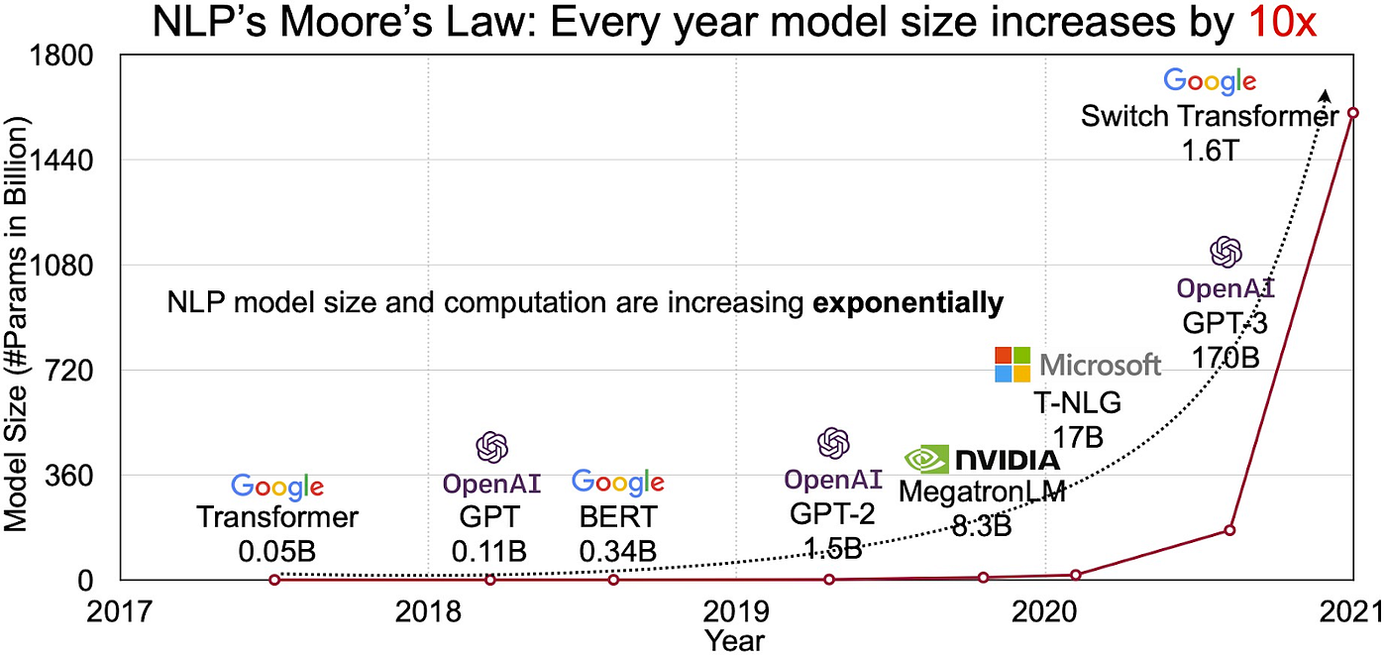
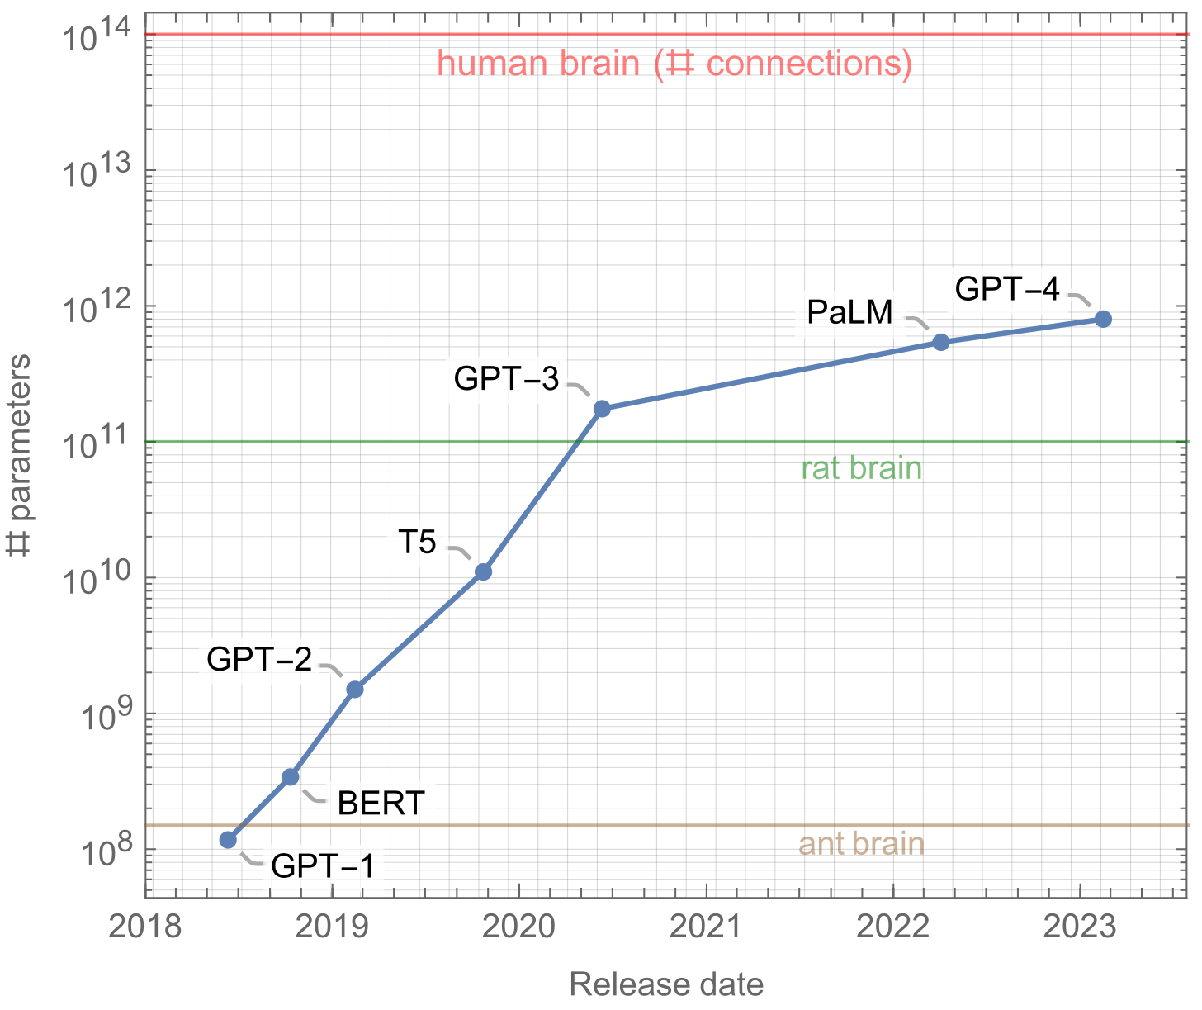
Moore’s law has affected model size.
Need to recreate the chart, then add the ant, rat, human lines for comparison
Fruit fly has 3016 neurons with 548k connections among 3016 neurons
Rat Brain has 600M connections among 200 million neurons
Human brain has 100 trillion connections among 86 billion neurons
https://pub.towardsai.net/how-do-8-smaller-models-in-gpt4-work-7335ccdfcf05

Slide 23
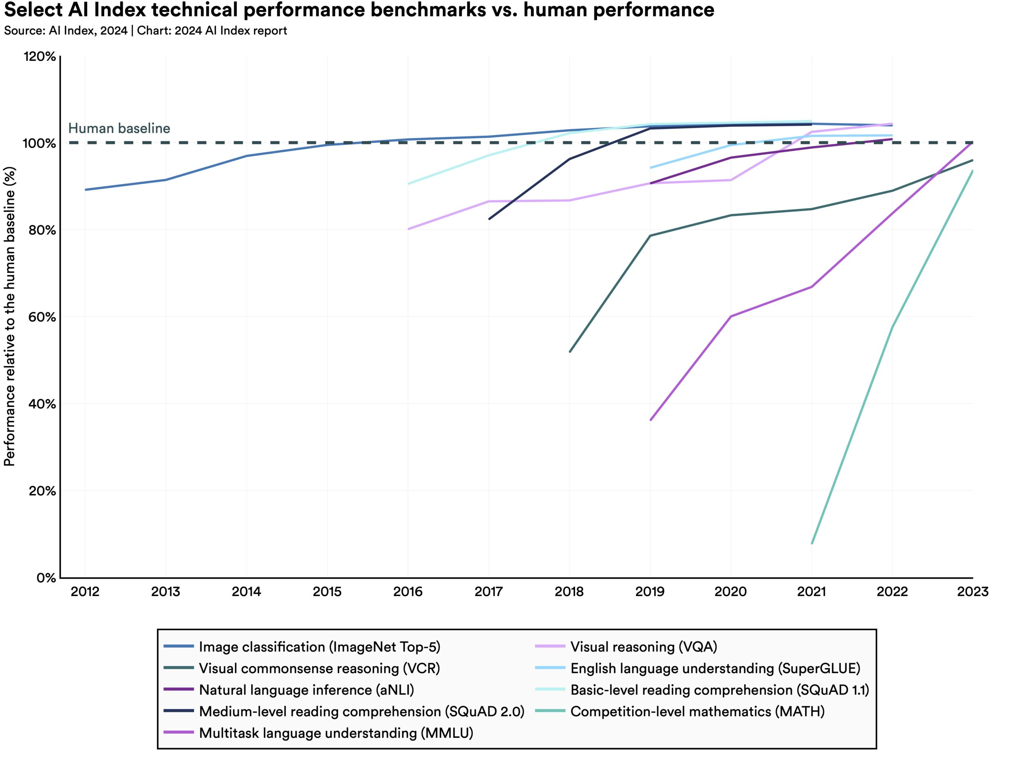
How much have models improved compared to average human data set tasks?
https://aiindex.stanford.edu/report/

Slide 24
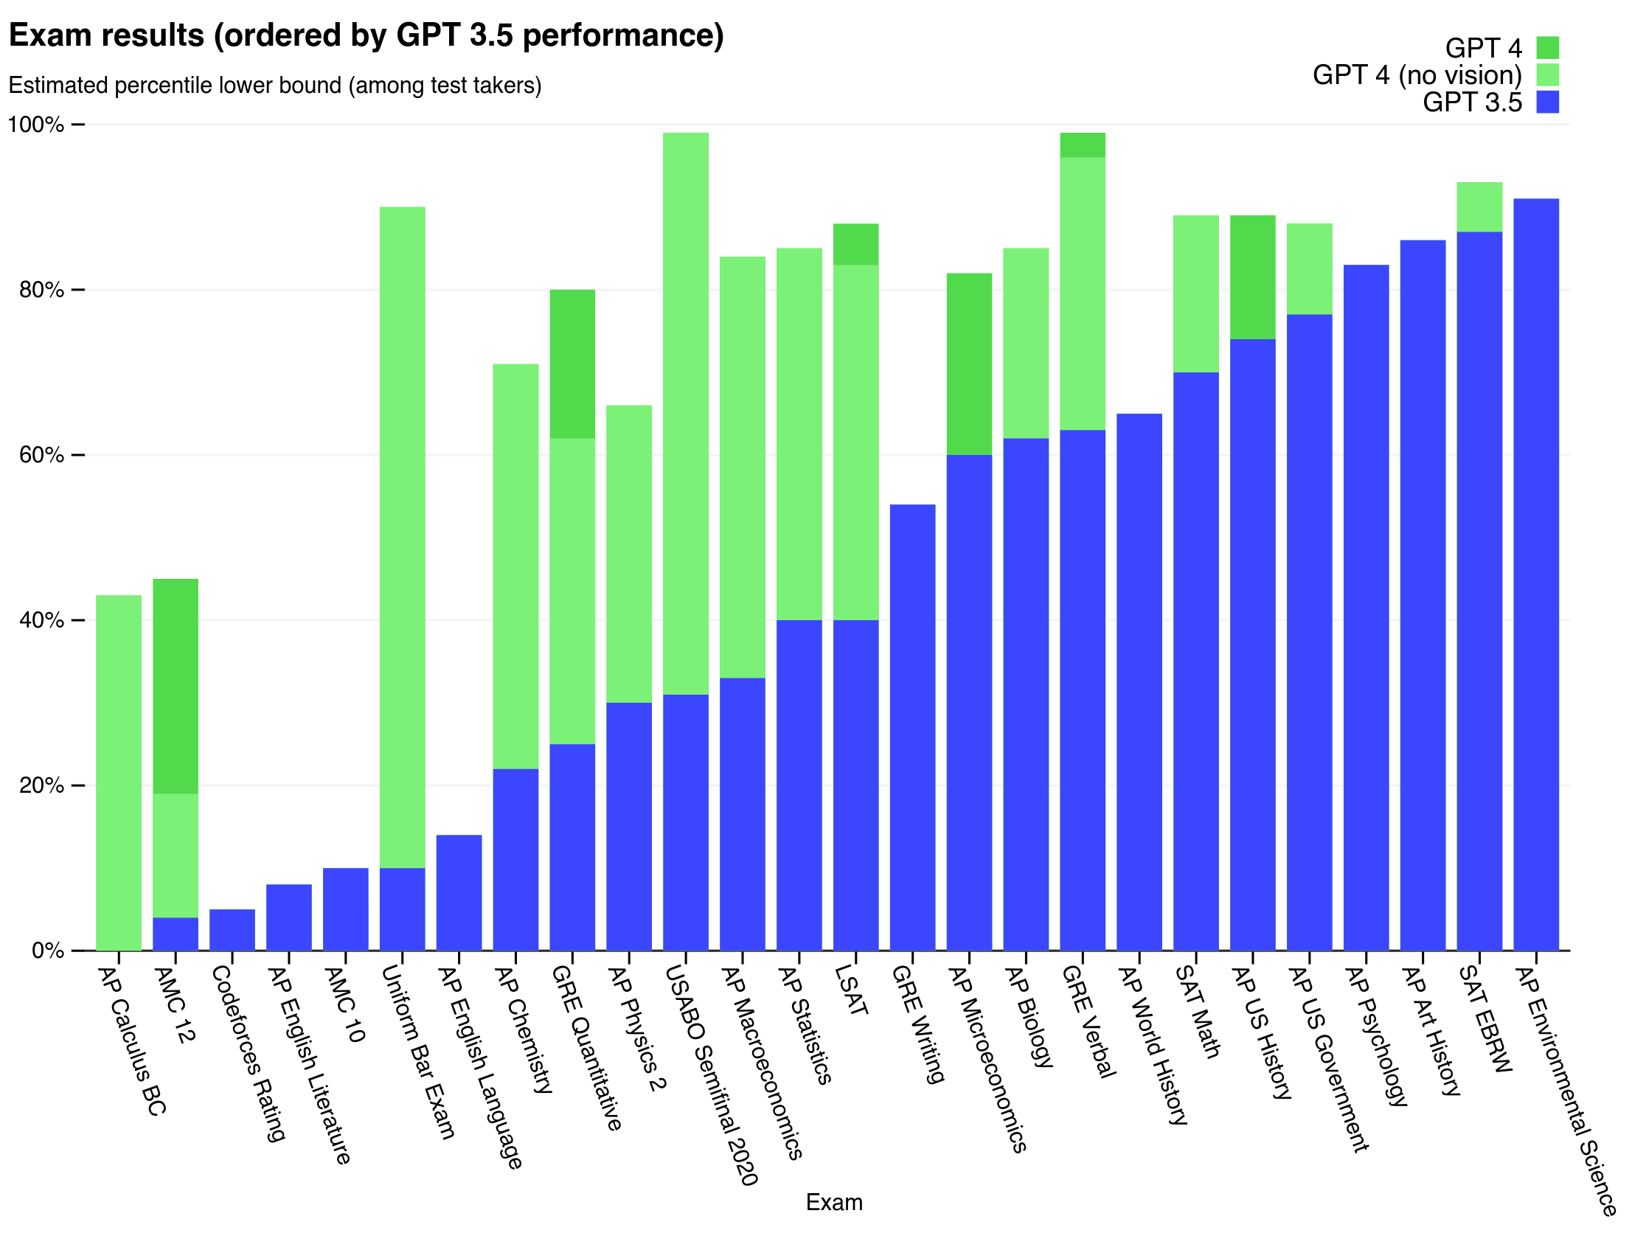
Models applied to standardized tests have also shown significant gains

Slide 25
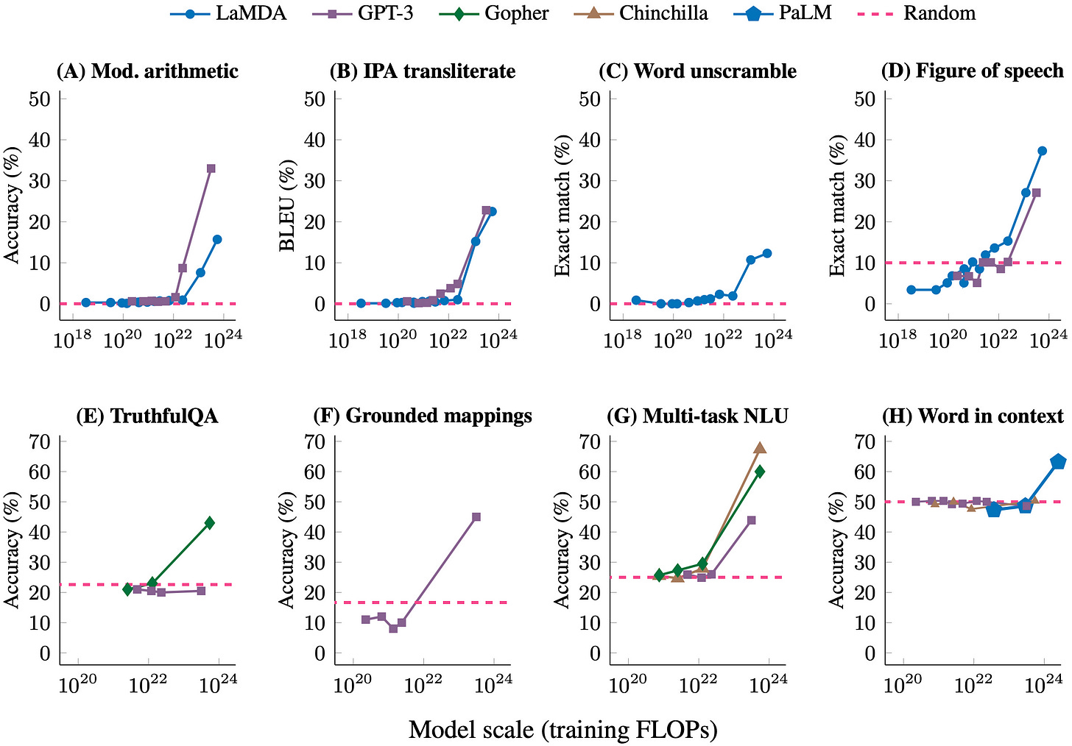
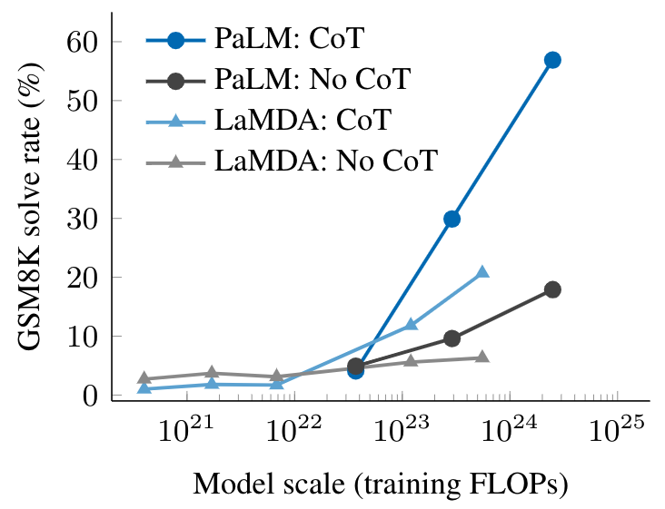
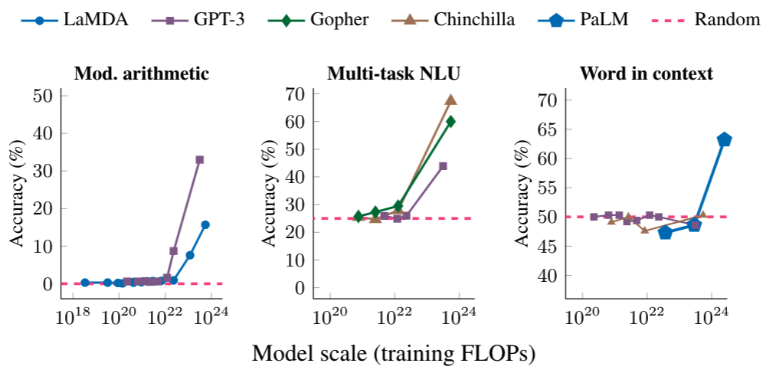
Start here
https://research.google/blog/characterizing-emergent-phenomena-in-large-language-models/
researchers may not know the full scope of few-shot prompted abilities of current language models. Moreover, the emergence of new abilities as a function of model scale raises the question of whether further scaling will potentially endow even larger models with new emergent abilities.
https://levelup.gitconnected.com/why-is-chatgpt-so-awesome-new-capabilities-emerge-when-the-language-model-is-large-enough-f25b3ab33439
Small models don’t help…bigger models are rushing to make bigger models; other methods beyond brute force may be needed but for now this is why there is a rush to compute, data and talent

Slide 26
Emergent Behavior slide 1 from book

Slide 27
Emergent Behavior slide 2 from book

Slide 28
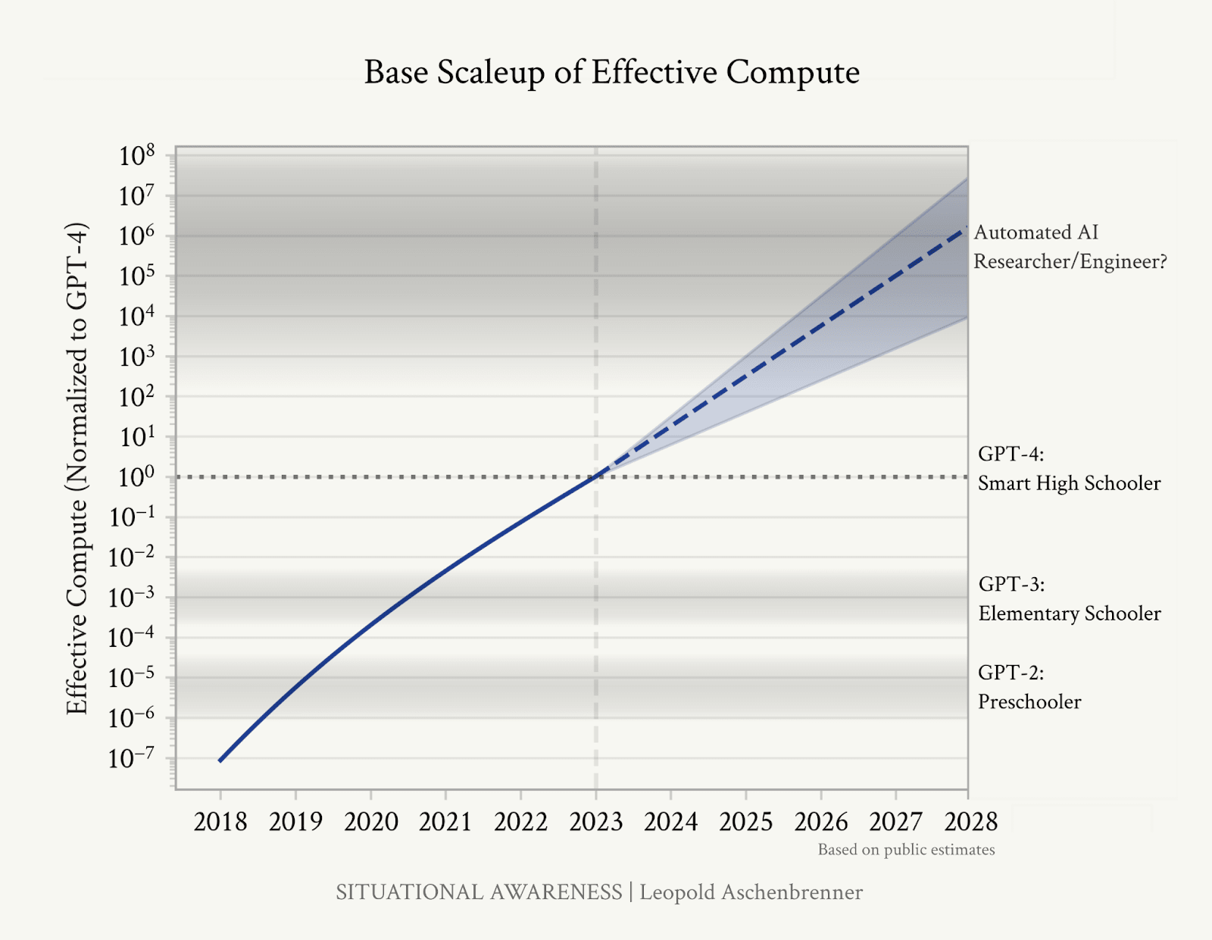
If you believe the hype
Exponential phenomenon is rare/dramative
Last time we have exponential growth we have Moore’s law - creating the digital revolution…the rise of Intel, Microsoft exists as a recognition that software can be supported with better compute; the internet flowed out of moore’s law letting computers be connected and perform more than originally thought possible
If the current exponential continues what does it mean? Another dramatic revolution this time in AI
Elon AGI is coming because he asserts the moore;s law will continue to be extended—2028 it will reach AI research scientist for itself?!

Slide 29
Scarce Resources
Compute 10^22 not interesting/compelling after that…exponential usefulness and performance
Data
Talent

Slide 30
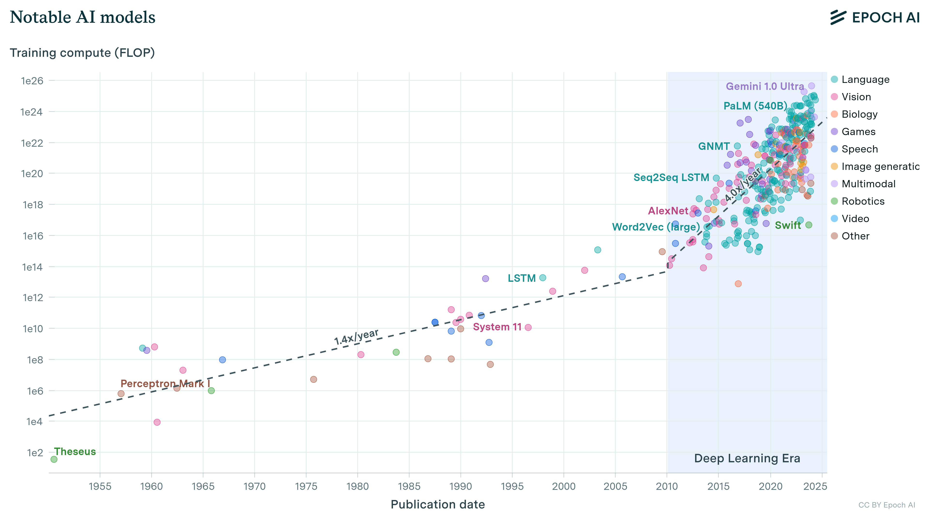
How much compute?
AI training time, in a pre deep learning era, training time compute needs doubled every 21.6months, now training time compute needs doubles every 6 months
This is why the world can’t get enough GPUs for training & with expanded usage GPUs for inference
https://epoch.ai/blog/compute-trends

Slide 31
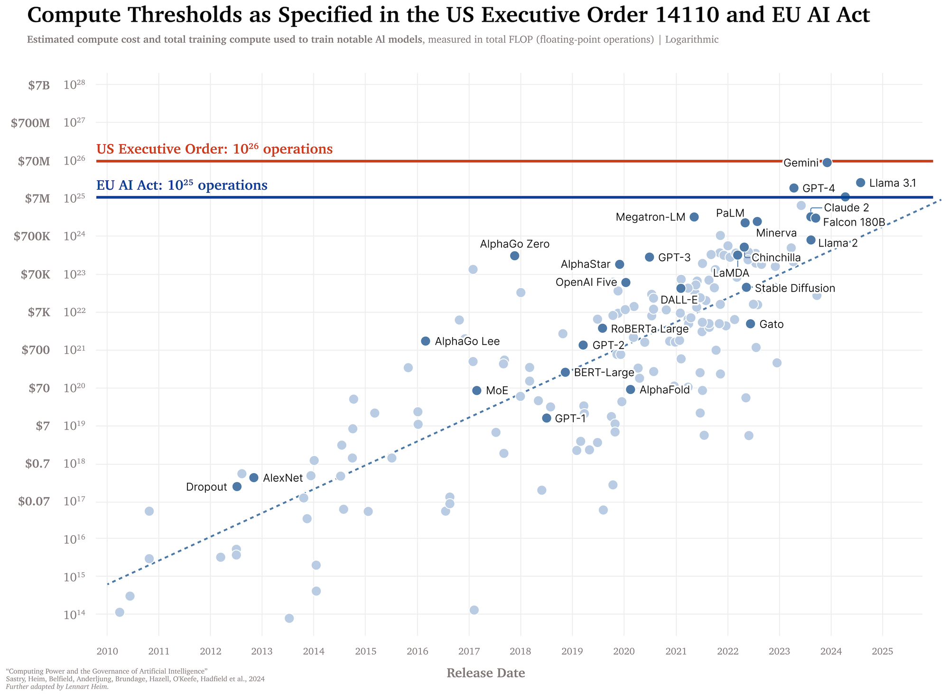
Exec Order 14110 – be careful about the models, and who can build them
If you have a model that can perform 10^26 operations you have to report it
1 month after announcement, the first model reached it
https://blog.heim.xyz/training-compute-thresholds/

Slide 32
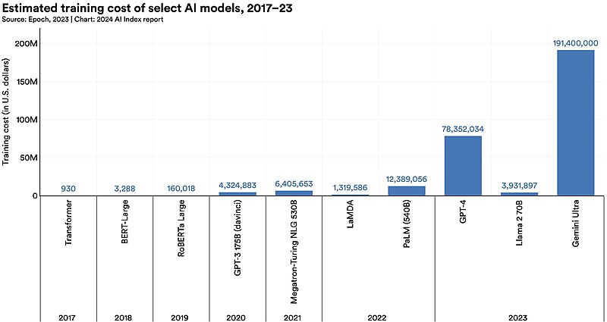
The ability to build models is concentrated; this presents a big problem, economic barriers to joining and competing
https://commons.wikimedia.org/wiki/File:Estimated_training_cost_of_some_AI_models_-_2024_AI_index.jpg

Slide 33
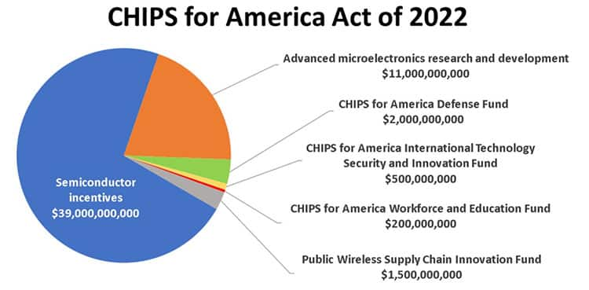
Compute is essential
https://www.digikey.ro/ro/blog/tech-community-gets-behind-chips-act

Slide 34
Computer game industry
Self Driving Car industry
Crypto Currency Industry
AI industry
Robotics
Defense

Slide 35

Users
AI Industry Stack
End to End applications
Ex. Midjourney, runway
Apps
Grammarly
Github copilot, customer service chatbot
What risks are there in this stack?
Data
Privacy
Bias
Transparency
Dependencies
Vendor lock in
Unknown data inputs
Interdependency on architecture
Lack of access to compute could be a fundamental deterrent
Security
Data mgt, quality, governance
Ai inventory/sprawl of the app layer
Closed weight foundation models
ChatGPT 01
Model hub – platform to share and host models
Hugging face, replicate
Open weight models
Llama 3
Cloud Platforms
Compute hardware exposed to developers in a cloud provider
AWS, GCP, Azure, Digital Ocean
Compute Hardware
GPUs TPUs to accelerate training and inference of these models

Slide 36
End to End applications
Ex. Midjourney, runway
Apps
Grammarly
Github copilot, customer service chatbot
Applications
Closed weight foundation models
ChatGPT 01
Model hub – platform to share and host models
Hugging face, replicate
Models
Open weight models
Llama 3
Cloud
Cloud Platforms
Compute hardware exposed to developers in a cloud provider
AWS, GCP, Azure, Digital Ocean
Lots of dependencies on chips
NVDA has 92% of chips
Cloud is concentrated with AWS, Azure and GCP
We have a few models, openAI, anthropic, Google, Cohere, Llama >>takes $192M to train a model, so its not like every one can do it
Chips
Compute Hardware
GPUs TPUs to accelerate training and inference of these models

Slide 37
Applications
Why has the VC return on AI been 0?
VC put in $500,000,000 in genAI and exits are ~$6M ? Verify this bc I don’t think its true.r
So many applications, most will fail, and even if they succeed why wouldn’t an incumbent mimic it
Double marginalization at every layer
Models
Cloud
Chips

Slide 38
Double Marginalization slide 1
Double marginalization is a phenomenon that occurs when two firms with market power (i.e., not in a situation of perfect competition), at different vertical levels in the same supply chain, apply a mark-up to their prices. This means that both the upstream (e.g., manufacturer) and downstream (e.g., retailer) firms add a profit margin to their costs, leading to a higher final price for consumers than would be optimal.
Here's a breakdown:
Market Power: Both the upstream and downstream firms have some control over their respective prices.They are not "price takers" like in perfect competition where they have to accept the market price.
Successive Markups: The upstream firm sets a wholesale price with a mark-up over its costs. The downstream firm then buys at this wholesale price and adds its own mark-up to determine the retail price.
Reduced Consumer Surplus: This double mark-up leads to a higher retail price than if the supply chain were integrated (one company controlling both production and distribution). This reduces consumer surplus (the difference between what consumers are willing to pay and what they actually pay).
Reduced Overall Profit: Surprisingly, double marginalization can also reduce the overall profit for both firms in the supply chain compared to a scenario where they cooperate or integrate.
Consequences of Double Marginalization:
Higher Prices for Consumers: The most obvious consequence is that consumers end up paying more for the product.
Reduced Quantity: The higher price can lead to a decrease in demand, resulting in lower overall sales volume.
Reduced Efficiency: Double marginalization creates inefficiencies in the supply chain as it distorts the optimal price and quantity levels.
Solutions to Double Marginalization:
Vertical Integration: The most common solution is for the upstream and downstream firms to merge, forming a single entity. This eliminates the separate profit margins and allows for coordinated pricing decisions.
Franchising: The upstream firm can grant a franchise to the downstream firm, often involving a fixed fee and royalties. This can incentivize the downstream firm to maximize overall sales and profits.
Two-Part Tariffs: The upstream firm can use a two-part tariff, charging a fixed fee and a per-unit fee. This can align the incentives of both firms by allowing the upstream firm to capture some of the downstream firm's profits.
Quantity Discounts: The upstream firm can offer quantity discounts to the downstream firm, encouraging them to purchase and sell more units.
In essence, double marginalization highlights the potential inefficiencies that can arise when independent firms with market power operate at different levels of the same supply chain.

Slide 39
Double Marginalization slide 2
Double marginalization is a phenomenon that occurs when two firms with market power (i.e., not in a situation of perfect competition), at different vertical levels in the same supply chain, apply a mark-up to their prices. This means that both the upstream (e.g., manufacturer) and downstream (e.g., retailer) firms add a profit margin to their costs, leading to a higher final price for consumers than would be optimal.
Here's a breakdown:
Market Power: Both the upstream and downstream firms have some control over their respective prices.They are not "price takers" like in perfect competition where they have to accept the market price.
Successive Markups: The upstream firm sets a wholesale price with a mark-up over its costs. The downstream firm then buys at this wholesale price and adds its own mark-up to determine the retail price.
Reduced Consumer Surplus: This double mark-up leads to a higher retail price than if the supply chain were integrated (one company controlling both production and distribution). This reduces consumer surplus (the difference between what consumers are willing to pay and what they actually pay).
Reduced Overall Profit: Surprisingly, double marginalization can also reduce the overall profit for both firms in the supply chain compared to a scenario where they cooperate or integrate.
Consequences of Double Marginalization:
Higher Prices for Consumers: The most obvious consequence is that consumers end up paying more for the product.
Reduced Quantity: The higher price can lead to a decrease in demand, resulting in lower overall sales volume.
Reduced Efficiency: Double marginalization creates inefficiencies in the supply chain as it distorts the optimal price and quantity levels.
Solutions to Double Marginalization:
Vertical Integration: The most common solution is for the upstream and downstream firms to merge, forming a single entity. This eliminates the separate profit margins and allows for coordinated pricing decisions.
Franchising: The upstream firm can grant a franchise to the downstream firm, often involving a fixed fee and royalties. This can incentivize the downstream firm to maximize overall sales and profits.
Two-Part Tariffs: The upstream firm can use a two-part tariff, charging a fixed fee and a per-unit fee. This can align the incentives of both firms by allowing the upstream firm to capture some of the downstream firm's profits.
Quantity Discounts: The upstream firm can offer quantity discounts to the downstream firm, encouraging them to purchase and sell more units.
In essence, double marginalization highlights the potential inefficiencies that can arise when independent firms with market power operate at different levels of the same supply chain.

Slide 40
Lots of risk, monopoly – basic “can I build one” fundamentally the answer is no.
Applications
It’s a vertically integrated stack.
Google
Meta, openAI/MSFT, apple
Models
Google
Meta, openAI/MSFT
Cloud
Google
Amazon, Microsoft
Chips
Google
Amazon, Nvidia, AMD

Slide 41
Vertical Integration Stack definition
Vertical integration, a business strategy where a company expands its operations by acquiring or merging with businesses at different stages of the same production process, has been employed by numerous companies throughout history. Here are some prominent examples:
Carnegie Steel: Andrew Carnegie's steel company, which dominated the American steel industry in the late 19th century, was a prime example of vertical integration. Carnegie controlled every aspect of steel production, from iron ore mining and coal extraction to steel manufacturing and transportation. This allowed him to control costs and quality, leading to significant profits and market dominance.
Standard Oil: John D. Rockefeller's Standard Oil Company also employed vertical integration to achieve its dominance in the oil industry. Rockefeller controlled oil drilling, refining, transportation (through pipelines and railroads), and distribution, giving him a significant competitive advantage.
Ford Motor Company: Henry Ford's assembly line revolutionized automobile production, and his company also practiced vertical integration. Ford controlled the production of many automobile components, including steel, glass, and rubber, as well as its own transportation and distribution networks. This allowed Ford to maintain tight control over quality and costs, leading to the mass production and affordability of the Model T.
Apple: While not as vertically integrated as some of the historical examples, Apple has increasingly moved towards controlling more of its supply chain. It designs its own hardware and software, and has also acquired companies involved in chip manufacturing and other key components. This allows Apple to maintain tight control over product quality, innovation, and the user experience.
Tesla: Tesla is another modern example of a vertically integrated company. It designs and manufactures its own electric vehicles, batteries, and charging infrastructure. This allows Tesla to control the entire electric vehicle ecosystem, from production to charging and maintenance.
These examples demonstrate the potential benefits of vertical integration, such as cost control, quality assurance, and increased market power. However, it's important to note that vertical integration can also have drawbacks, such as increased complexity, inflexibility, and potential antitrust concerns.
Sources and related content

Slide 42
Vertical Integration Stack examples
Vertical integration, a business strategy where a company expands its operations by acquiring or merging with businesses at different stages of the same production process, has been employed by numerous companies throughout history. Here are some prominent examples:
Carnegie Steel: Andrew Carnegie's steel company, which dominated the American steel industry in the late 19th century, was a prime example of vertical integration. Carnegie controlled every aspect of steel production, from iron ore mining and coal extraction to steel manufacturing and transportation. This allowed him to control costs and quality, leading to significant profits and market dominance.
Standard Oil: John D. Rockefeller's Standard Oil Company also employed vertical integration to achieve its dominance in the oil industry. Rockefeller controlled oil drilling, refining, transportation (through pipelines and railroads), and distribution, giving him a significant competitive advantage.
Ford Motor Company: Henry Ford's assembly line revolutionized automobile production, and his company also practiced vertical integration. Ford controlled the production of many automobile components, including steel, glass, and rubber, as well as its own transportation and distribution networks. This allowed Ford to maintain tight control over quality and costs, leading to the mass production and affordability of the Model T.
Apple: While not as vertically integrated as some of the historical examples, Apple has increasingly moved towards controlling more of its supply chain. It designs its own hardware and software, and has also acquired companies involved in chip manufacturing and other key components. This allows Apple to maintain tight control over product quality, innovation, and the user experience.
Tesla: Tesla is another modern example of a vertically integrated company. It designs and manufactures its own electric vehicles, batteries, and charging infrastructure. This allows Tesla to control the entire electric vehicle ecosystem, from production to charging and maintenance.
These examples demonstrate the potential benefits of vertical integration, such as cost control, quality assurance, and increased market power. However, it's important to note that vertical integration can also have drawbacks, such as increased complexity, inflexibility, and potential antitrust concerns.
Sources and related content

Slide 43
Vertical Integration Stack postivie – less marginalization i.e. apple; promotes efficiency
Vertical Integration Stack negative – innovation, domination, stagnation – look at intel didn’t catch mobile wave, didn’t catch ai

Slide 44
Lots of risk, monopoly – basic “can I build one” fundamentally the answer is no.
Applications
It’s a vertically integrated stack.
Google
Meta, openAI/MSFT, apple
Google and MSFT
Once the stack is built they own it moving up the stack to control it; there is no reason why the lower parts of the stack wouldn’t bring it in house.
Remember the original iphone flashlight application wasn’t from apple? Once you have a successful app they will copy it,and you can’t compete, they can often make it free, optimize if for their hardware etc.
Why the rush? Once you own the stack you own the ecosystem/platform and can just mimic anything successful. Successful applications are the guinea pigs and once successful they will co-opt and bring in house
Models
Google
Meta, openAI/MSFT
Cloud
Google
Amazon, Microsoft
Chips
Google
Amazon, Nvidia, AMD

Slide 45
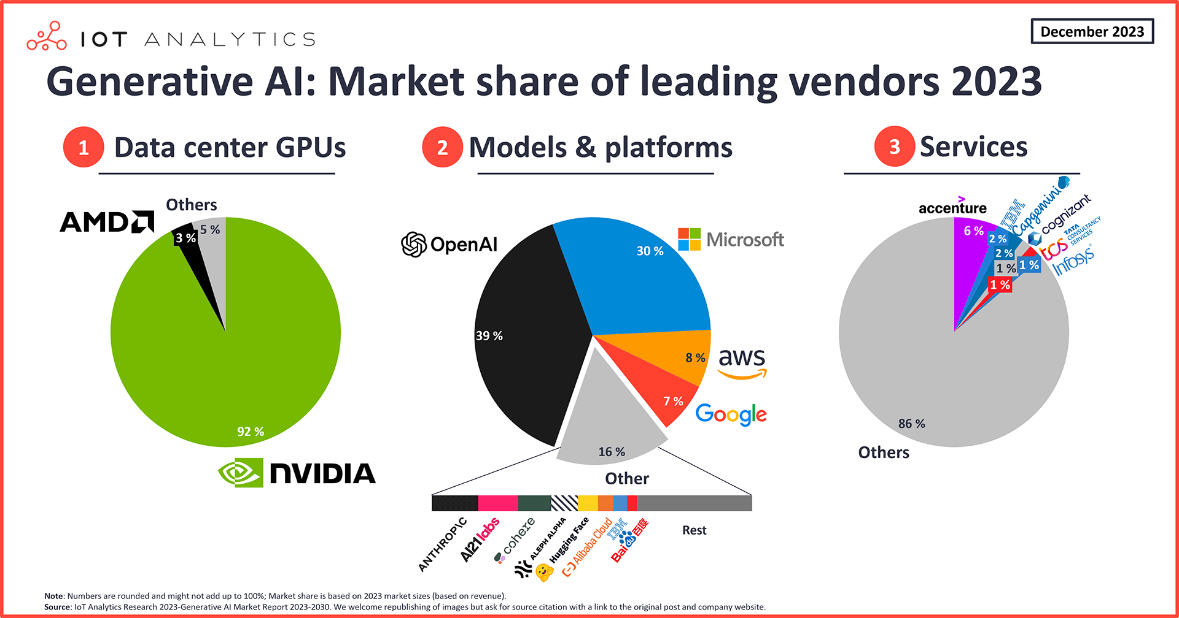
Concentration throughout

Slide 46
Delve into each element of the stack
Think about industry dynamics
Think about firm strategy as a user of ai

Slide 47
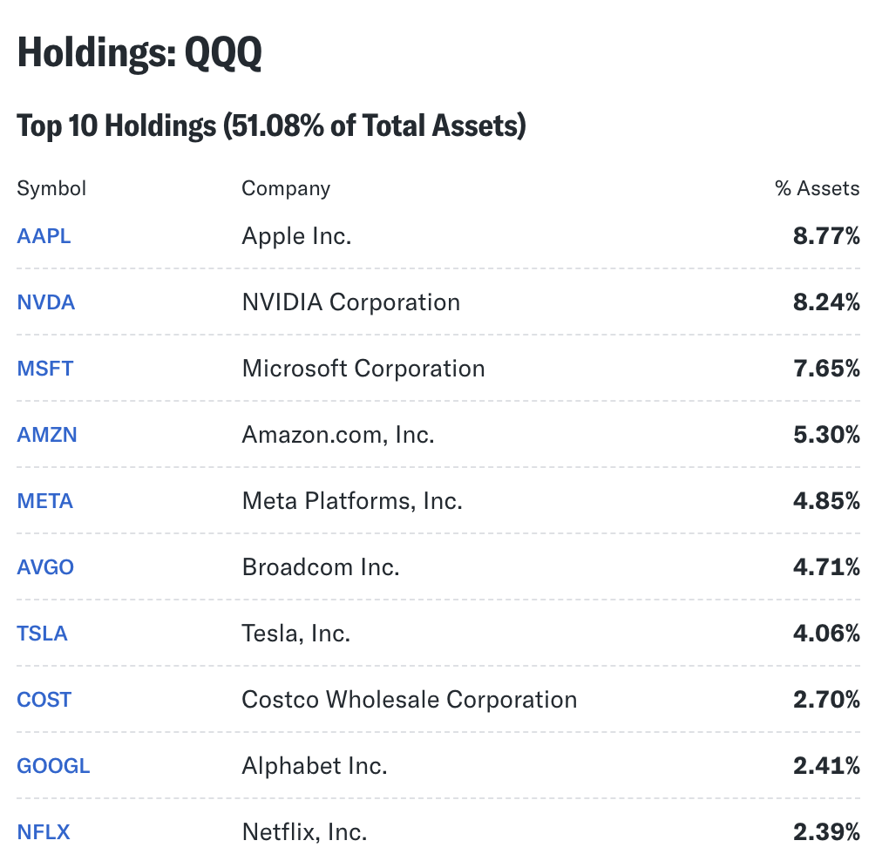
Chips double click
9/10 tech companies
Apple makes chips (M4 etc)
Nvda makes chips
Msft makes chips (Maia 100)
Amazon makes chips (Gravitron, Trainium, Inferentia)
Meta makes chips, MTIA ASIC
Broadcom makes chips
Tesla makes its own chips
Google makes its own chips TPU
Netflix – doesn’t make its own chips but has noted a strategic threat is reliance on AWS

Slide 48
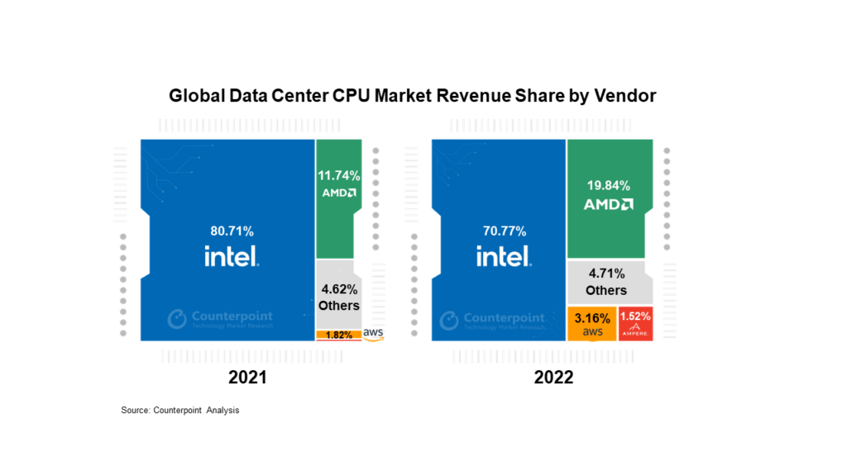
Chips are essential in the AI era, the cyrpto era, the competitive gaming, massively multiplayer online game (MMOG), robotics, defense and self-driving cars
https://iot-analytics.com/leading-generative-ai-companies/
https://ms.codes/blogs/computer-hardware/data-center-cpu-market-share

Slide 49
Wont the chip act bring back the industry to the US?
Chips
Chip Design
AMD, Nvdia, Google, Apple – they don’t manufacture them, they blueprint and and for manufacture
Chip Manufacture & Foundries
TSMC , Samsung & partnerships apple/tsmc, nvdia tsmc
Photolithography
ASML - $500M per machine that can etch ultraviolet light at 5nm

Slide 50
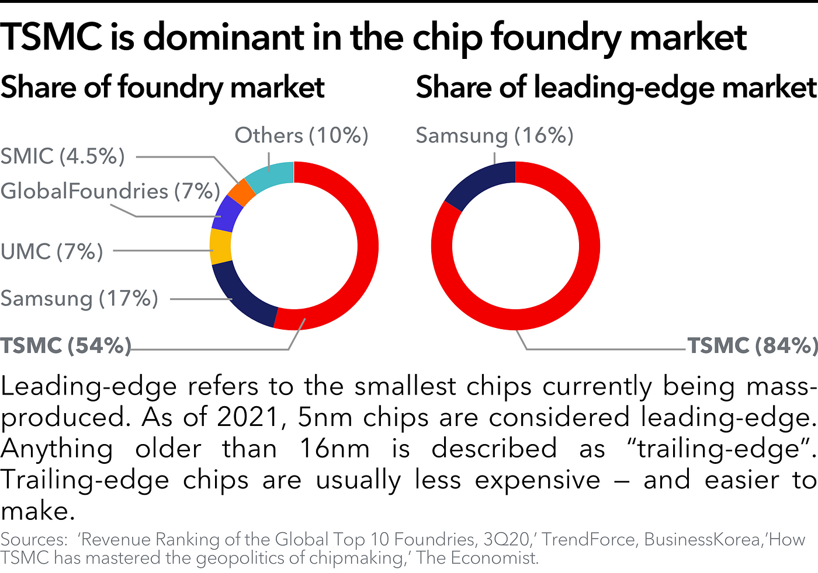
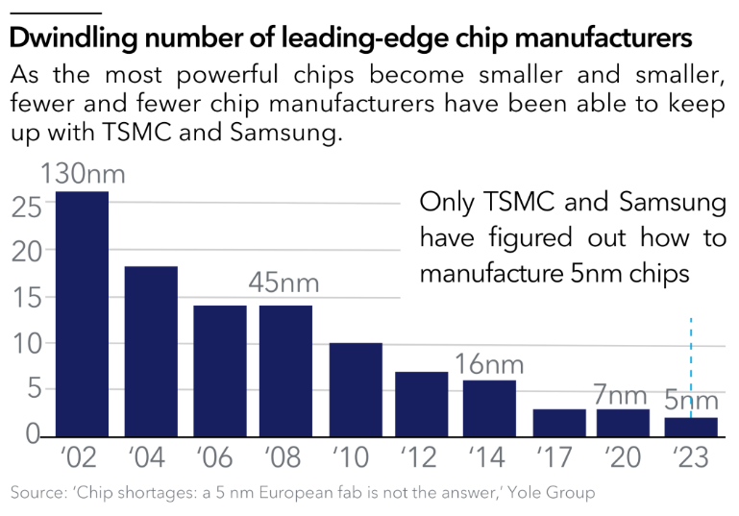

Slide 51
New chips and breaking the natural monopoly
Hyperscalers have $, incentive and tech talent to move down the stack
New chip development – samba nova, cerebras; roviero, syntiant, xilinkx; light matter

Slide 52
Another way to balance is to have specific chips for training and another inferencing
Groq logo

Slide 53
Takeaways
Chip industry is concentrated throughout the stack
Supply will continue to be constrained; price of chips will not fall but price of model inference will as model differences shrink or as tasks don’t need ever-more complex/larger models
Inference chips can help break the concentration – new stack changes can change the economics of the industry to be on the lookout for it
Moore’s law – compute is getting faster & cheaper VS concentration which may limit this

